Slide 1
VIT – AP UNIVERSITY SCHOOL OF COMPUTER SCIENCE AND ENGINEERING STORAGE TECHNOLOGY MANAGEMENT (SWE4005) Dr. G. MUNEESWARI PROFESSOR

Slide 2
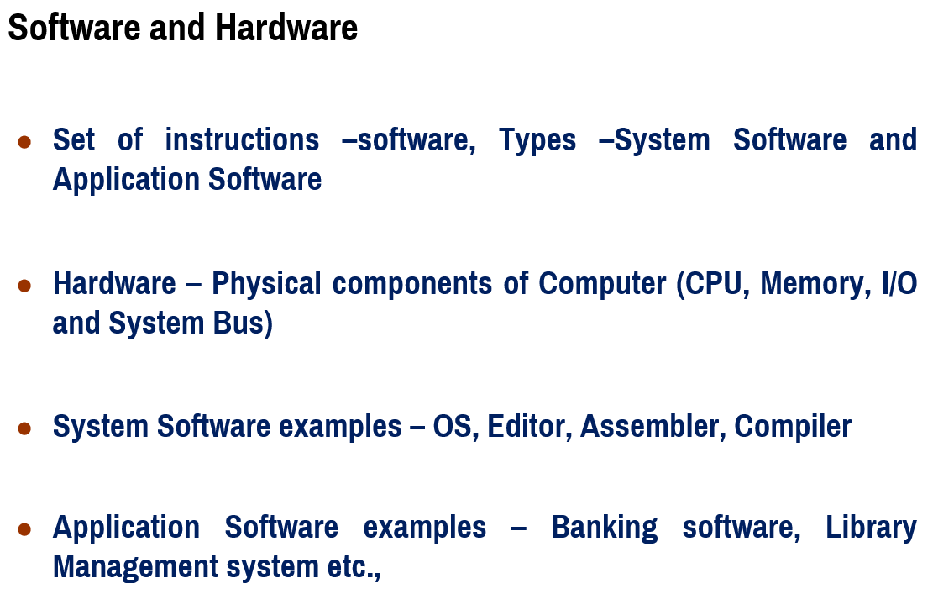

Slide 3
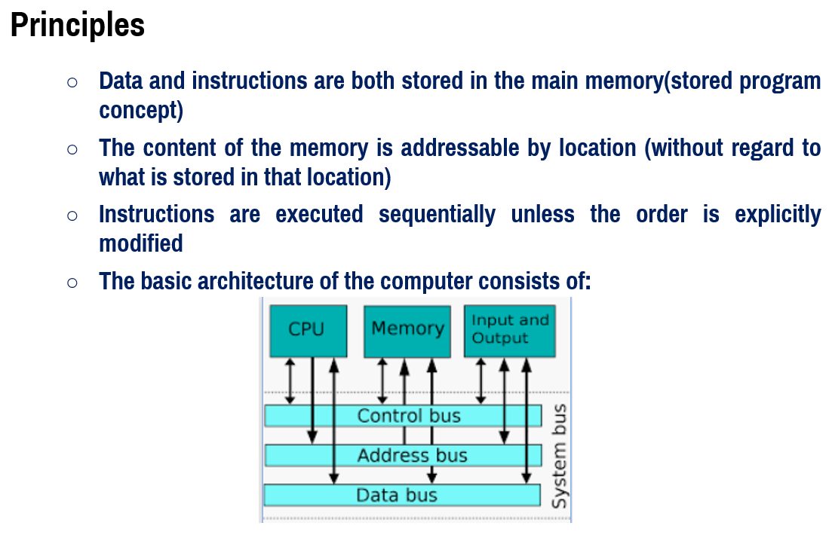

Slide 4
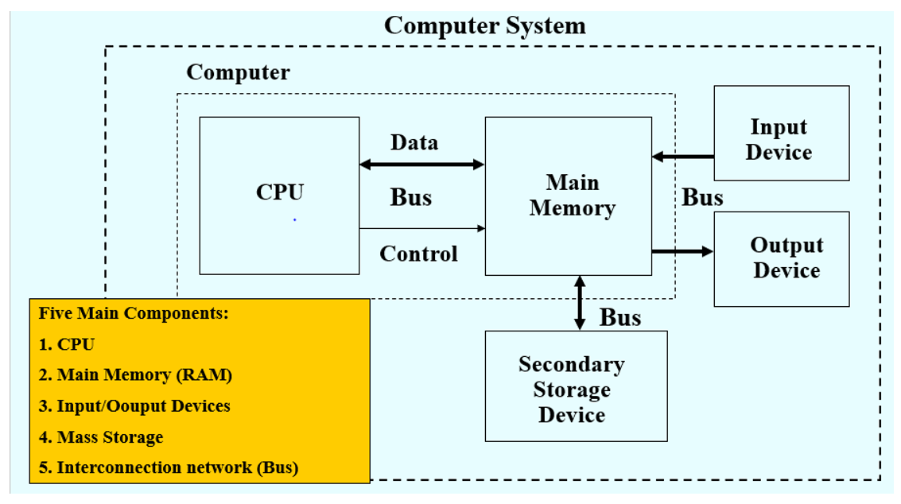
Functional Units of Computer

Slide 5
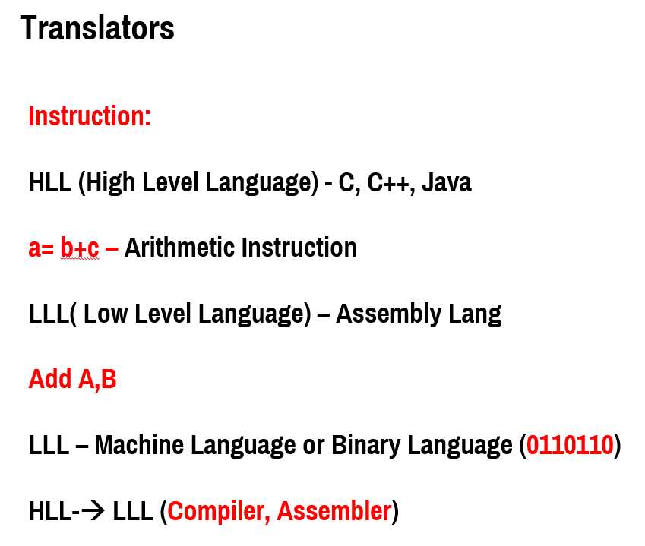

Slide 6
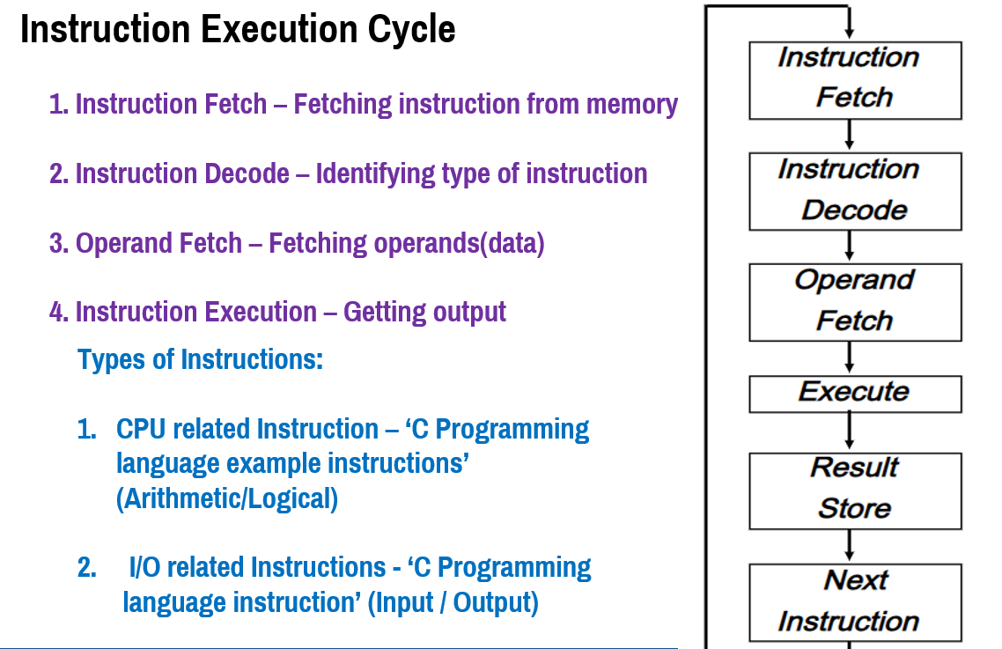

Slide 7
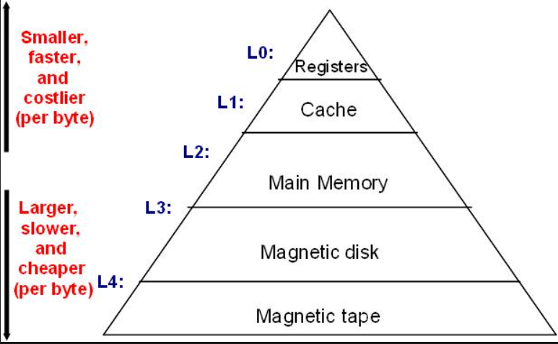
Memory Hierarchy

Slide 8
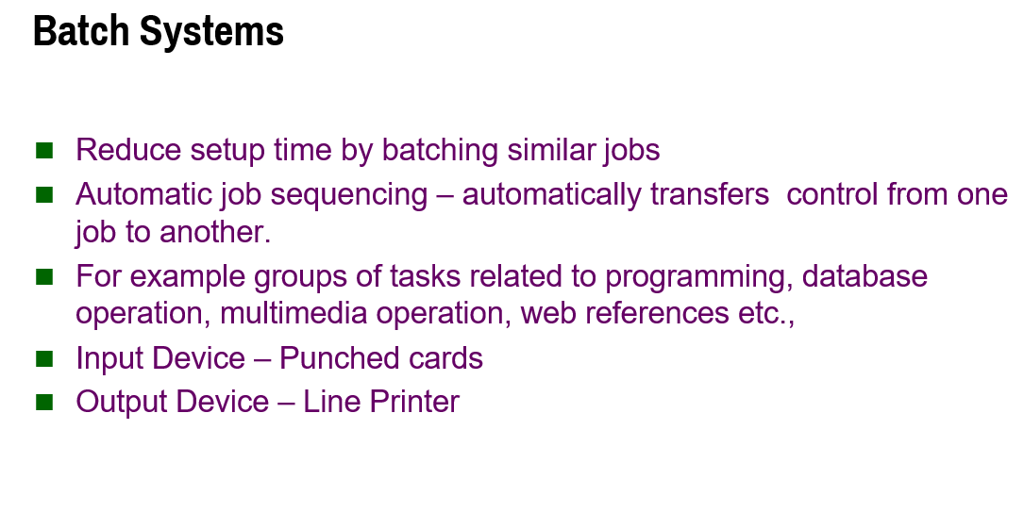

Slide 9
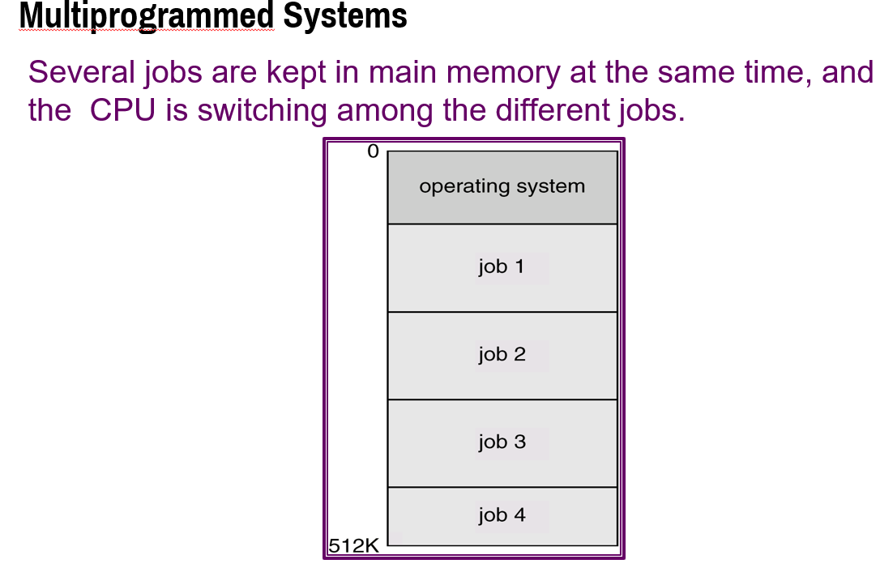

Slide 10
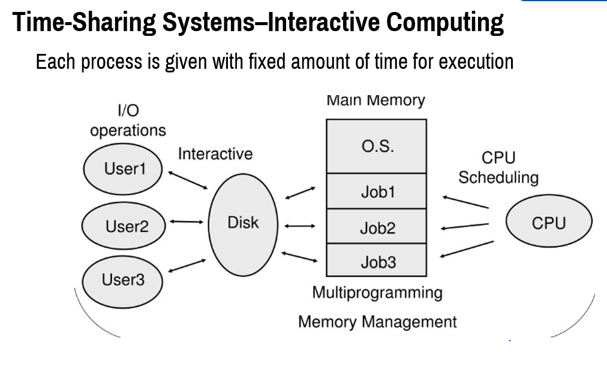

Slide 11
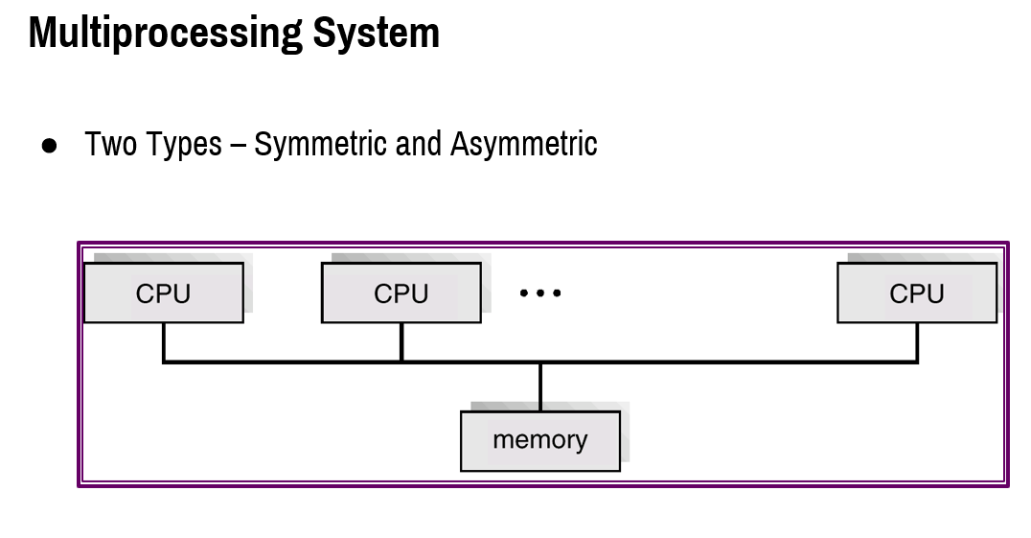

Slide 12
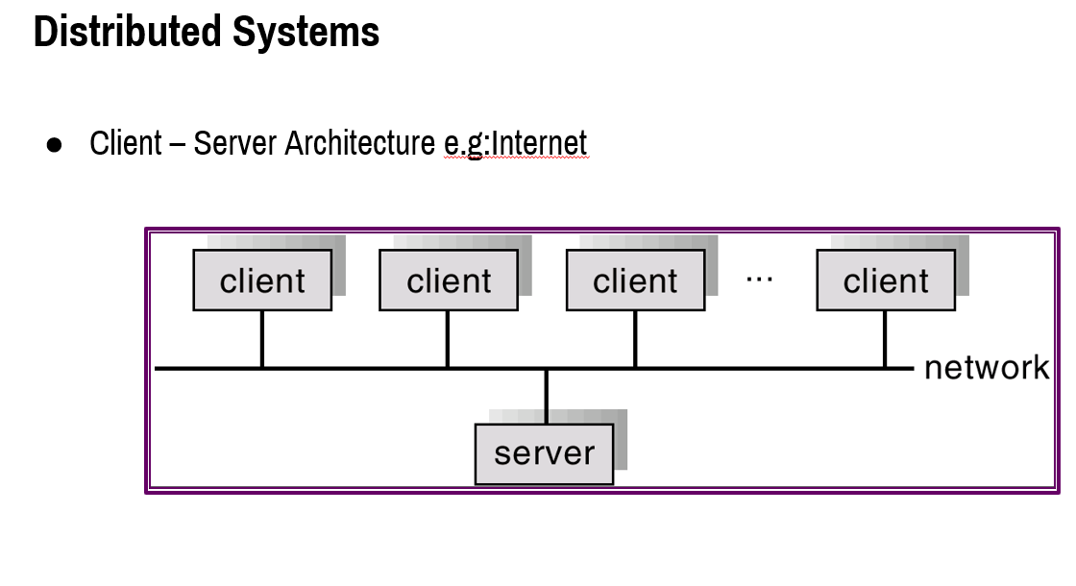

Slide 13
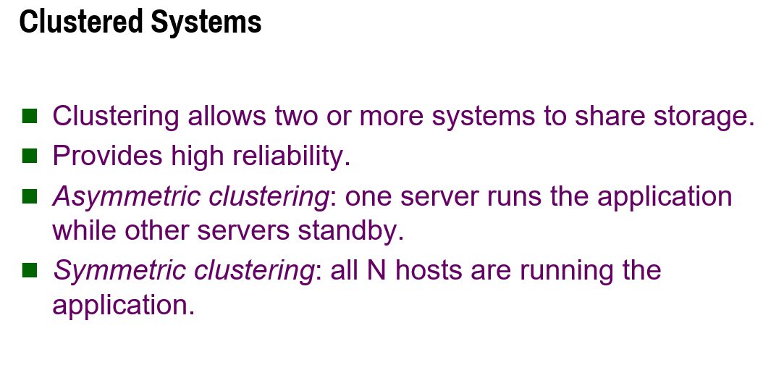

Slide 14
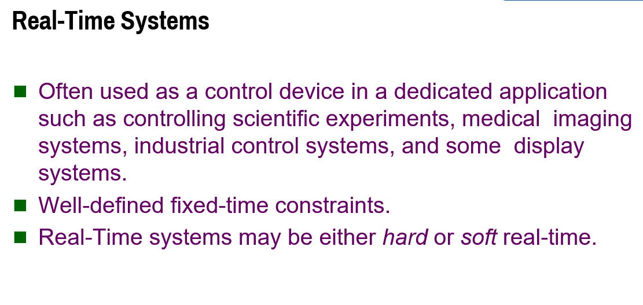

Slide 15
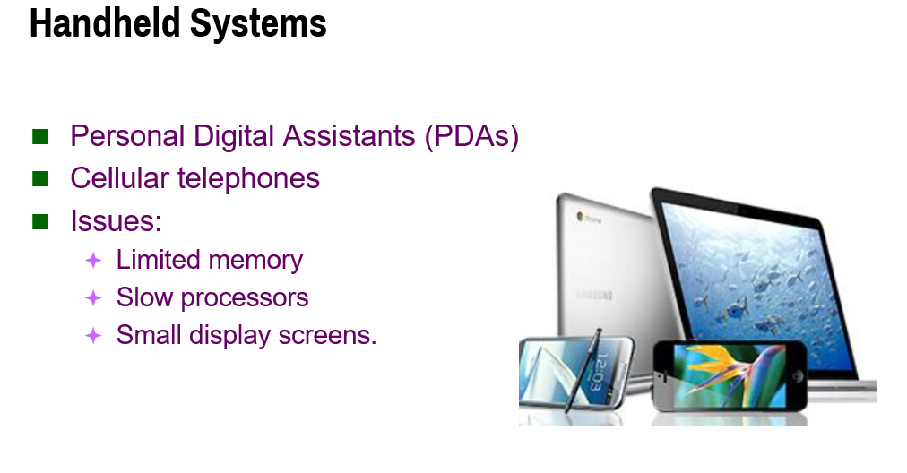

Slide 16
